Slide 1
Architectural Design
Fatima Fayyaz

Slide 2
Agenda
What is architecture?
Why is architecture important?
Data Design
Architectural Styles
Information Flows
Partitioning the architecture
Why partitioned architecture?
Quiz

Slide 3
What is Architecture?
Software architecture is the first step in producing a software design.
Requirements of the software should be transformed into an architecture that describes the software's top-level structure and identifies its components. This is accomplished through architectural design (also called system design), which acts as a preliminary 'blueprint' from which software can be developed.

Slide 4
What is Architecture?
IEEE defines architectural design as:
“The process of defining a collection of hardware and software components and their interfaces to establish the framework for the development of a computer system.”
This framework is established by examining the software requirements document and designing a model for providing implementation details.
The architectural design process results in an Architectural Design Document (ADD). This document consists of a number of graphical representations that comprises software models along with associated descriptive text.

Slide 5
What is Architecture?
Software architecture is a representation that enables a software engineer to
Analyze the effectiveness of the design in meeting stated requirements
Consider architectural alternatives
Reduce the risk associated with the construction of the software
Examine the system as a whole

Slide 6
Why is Architecture Important?
Enable communication between all parties (stakeholders) interested in the development of a computer-based system.
Highlights early design decisions that will have a profound impact on all software engineering work that follows and on the ultimate success of the system as an operational entity.
Architecture "constitutes a relatively small, intellectually graspable model of how the system is structured and how its components work together".

Slide 7
Data Design
Data design is the first design activity, which results in less complex, modular and efficient program structure.
The challenge is to store and retrieve the data in such a way that useful information can be extracted from the data environment
Data quality is the difference between a data warehouse and a data garbage dump

Slide 8
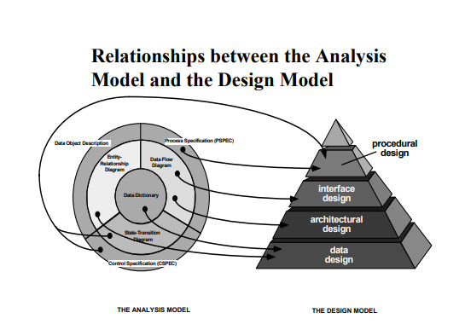
Relationship

Slide 9
Architectural Styles
The objective of using architectural styles is to establish a structure for all the components present in a system.
Data-flow Architecture - pipes
Object-oriented Architecture - methods
Layered Architecture - protocols
Data-centered Architecture – data store and collection of client software
Call and Return Architecture
Main program/subprogram architecture
Remote procedure call architecture

Slide 10
Structured Design
Objective: to derive a program architecture that is partitioned
Deriving program architecture
Data flow diagram → architecture

Slide 11
Information Flow
There are two types of information flow in DFDs:
Transform Flow:
A sequence of paths that form a transition through which input data are transformed into output data
Transaction Flow:
A information flow that is triggered by a single data item, called transaction along one of many paths

Slide 12
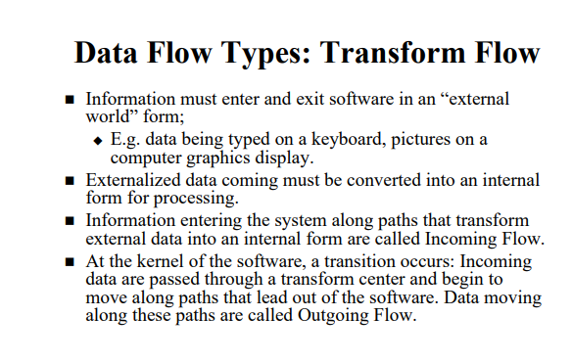
Information Flow- Transform Flow

Slide 13
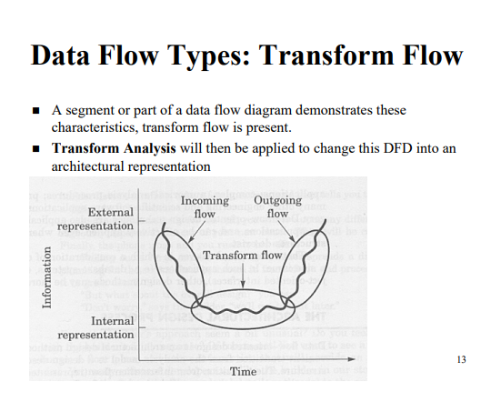
Information Flow- Transform Flow

Slide 14
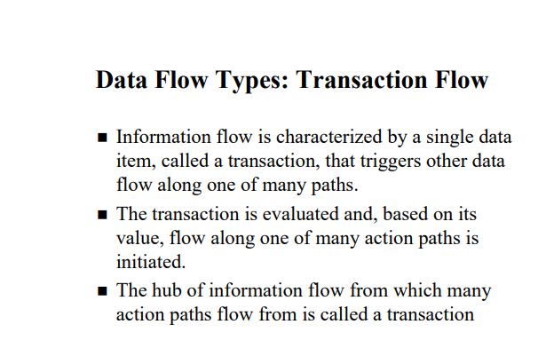
Information Flow- Transaction Flow

Slide 15
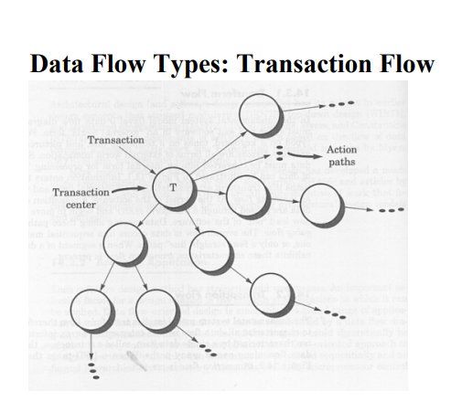
Information Flow- Transaction Flow

Slide 16
Partitioning the Architecture
The program structure should be partitioned in both ways:
Horizontal partitioning
Vertical partitioning

Slide 17
Partitioning the Architecture
1. Horizontal partitioning:
Defines separate branches of the modular hierarchy for each major program function.
Use control modules to coordinate communication between functions

Slide 18
Partitioning the Architecture
2. Vertical partitioning:
Suggests the control and work should be distributed top-down in program structure.
Design so that decision making and work are stratified
Decision making modules should reside at the top of the architecture

Slide 19
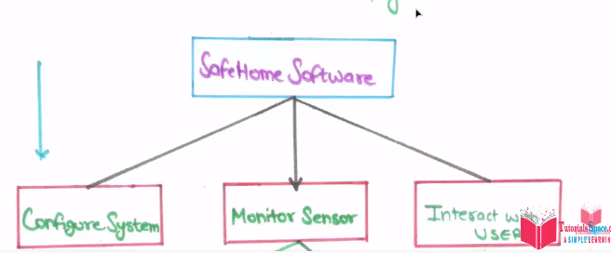
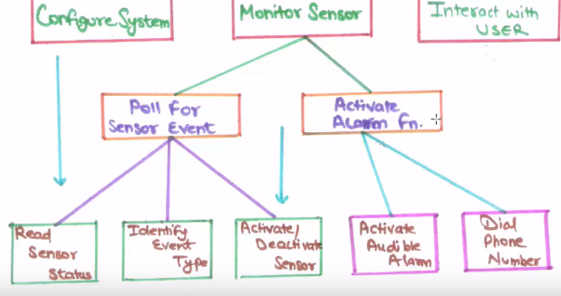
Partitioning the Architecture

Slide 20
Why Partitioned Architecture?
Results in software that is easier to test
Leads to software that is easier to maintain
Controlled bug rate
Results in software that is easier to extend

